Slide 1
Computer Instructions

Slide 2
Computer Instructions
Most computer instructions can be classified into three categories:
1. Data transfer instructions
2. Data manipulation instructions
3. Program control instructions
Data transfer instructions cause transfer of data from one location to another without changing the binary information content.
Data manipulation instructions are those that perform arithmetic, logic, and shift operations.
Program control instructions provide decision-making capabilities and change the path taken by the program when executed in the computer.

Slide 3
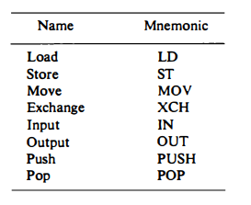
Data Transfer Instructions
Data transfer instructions move data from one place in the computer to another without changing the data content. The most common transfers are between memory and processor registers, between processor registers and input or output, and between the processor registers themselves.
The load instruction has been used mostly to designate a transfer from memory to a processor register, usually an accumulator.
The store instruction designates a transfer from a processor register into memory.
The move instruction has been used in computers with multiple CPU registers to designate a transfer from one register to another. It has also been used for data transfers between CPU registers and memory or between two memory words.
The exchange instruction swaps information between two registers or a register and a memory word.
The input and output instructions transfer data among processor registers and input or output terminals.
The push and pop instructions transfer data between processor registers and a memory stack.

Slide 4
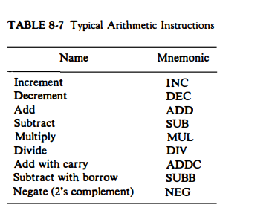
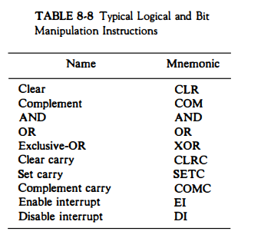
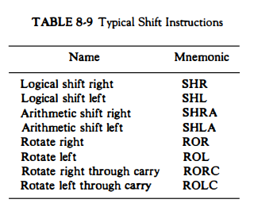
Data manipulation instructions
Data manipulation instructions perform operations on data and provide the computational capabilities for the computer.
The data manipulation instructions in a typical computer are usually divided into three basic types:
1. Arithmetic instructions
2. Logical and bit manipulation instructions
3. Shift instructions

Slide 5
Program Control Instructions
Instructions are always stored in successive memory locations.
When processed in the CPU, the instructions are fetched from consecutive memory locations and executed.
Each time an instruction is fetched from memory, the program counter is incremented so that it contains the address of the next instruction in sequence.
After the execution of a data transfer or data manipulation instruction, control returns to the fetch cycle with the program counter containing the address of the instruction next in sequence.
On the other hand, a program control type of instruction, when executed, may change the address value in the program counter and cause the flow of control to be altered.
Program control instructions modify or change the flow of a program. It is the instruction that alters the sequence of the program's execution, which means it changes the value of the program counter, due to which the execution of the program changes.

Slide 6
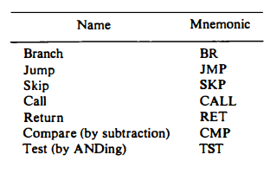
Program Control Instructions
Branch and jump instructions may be conditional or unconditional. When executed, the branch instruction causes a transfer of the value of ADR into the program counter.
A conditional skip instruction will skip the next instruction if the condition is met.
The call and return instructions are used in conjunction with subroutines.
The compare instruction performs a subtraction between two operands, but the result of the operation is not retained.
Similarly, the test instruction performs the logical AND of two operands and updates certain status bits without retaining the result or changing the operands.

Slide 7
Status Bit Conditions
It is sometimes convenient to supplement the ALU circuit in the CPU with a status register where status bit conditions can be stored for further analysis.
Status bits are also called condition-code bits or flag bits.
Block diagram of an 8-bit ALU with a 4-bit status register is shown.
The four status bits are symbolized by C, S, Z, and V. The bits are set or cleared as a result of an operation performed in the ALU.

Slide 8
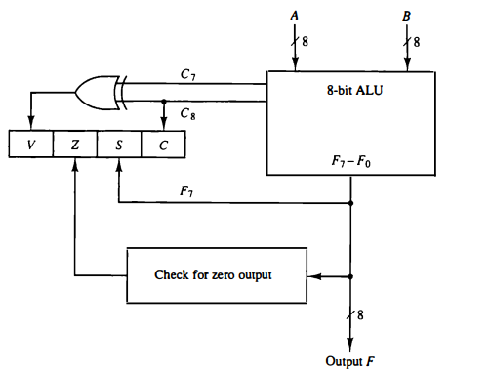
Status Register Bits
Bit C (carry) is set to 1 if the end carry C8 is 1. It is cleared to 0 if the carry is 0.
Bit S (sign) is set to 1 if the highest-order bit F, is 1. It is set to 0 if the bit is 0.
Bit Z (zero) is set to 1 ifthe output ofthe ALU contains all O's. !t is cleared to 0 otherwise. In other words, Z = 1 if the output is zero and Z = 0 if the output is not zero.
Bit V (overflow) is set to 1 if the exclusive-OR of the last two carries is equal to 1, and cleared to 0 otherwise. This is the condition for an overflow when negative numbers are in 2's complement.
For the 8-bit ALU, V = 1 if the output is greater than + 127 or less than - 128.
The status bits can be checked after an ALU operation to determine certain relationships that exist between the values of A and B.

Slide 9
Conditional Branch Instructions
A branch is an instruction in a computer program that can cause a computer to begin executing a different instruction sequence and thus deviate from its default behavior of executing instructions in order.
Each mnemonic is constructed with the letter B (for branch) and an abbreviation of the condition name. When the opposite condition state is used, the letter N (for no) is inserted to define the 0 state. Thus BC is Branch on Carry, and BNC is Branch on No Carry. If the stated condition is true, program control is transferred to the address specified by the instruction. If not, control continues with the instruction that follows. The conditional instructions can be associated also with the jump, skip, call, or return type of program control instructions.
The zero status bit is used for testing if the result of an ALU operation is equal to zero or not. The carry bit is used to check if there is a carry out of the most significant bit position of the ALU.
The sign bit reflects the state of the most significant bit of the output from the ALU. S = 0 denotes a positive sign and S = 1, a negative sign. Therefore, a branch on plus checks for a sign bit of 0 and a branch on minus checks for a sign bit of 1. It must be realized, however, that these two conditional branch instructions can be used to check the value of the most significant bit whether it represents a sign or not. The overflow bit is used in conjunction with arithmetic operations done on signed numbers in 2's complement representation.

Slide 10
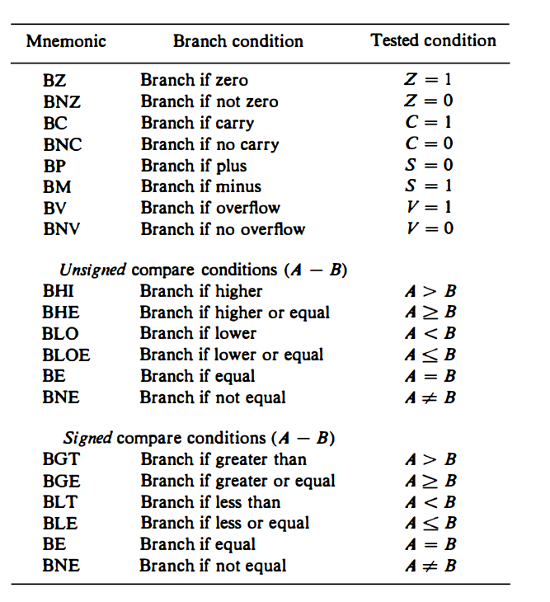
Conditional Branch Instructions

